Slide 1
NEXT WORD PREDICTON
18BCP071 - Niti Bhagat
18BCP028 - Dhruv Bosamia
18BCP068 – Nirmal Mahtea
18BCP132 – Yash Joshi

Slide 2
INTRODUCTION
Next word prediction model is an application which is trained on large amount of text data to predict next word based on previous words.
For e.g.
“ The grass is always … ”
The next word is “green” and could be predicted by most models and networks.

Slide 3
Problem statement
Given any input word and text file, predict the next n words that can occur after the input word in the text file.

Slide 4
DATASET
https://www.gutenberg.org/cache/epub/5200/pg5200.txt

Slide 5
Methodology Used:
Step 1 :- Importing important libraries such as numpy , keras.
Step 2 :- Cleaning the Data like removing punctuations etc.
Step 3 :- Converting words into numbers using Tokenization.
Step 4 :- Create sequences of words to fit the model with 1 word as input and 1 word as output.

Slide 6
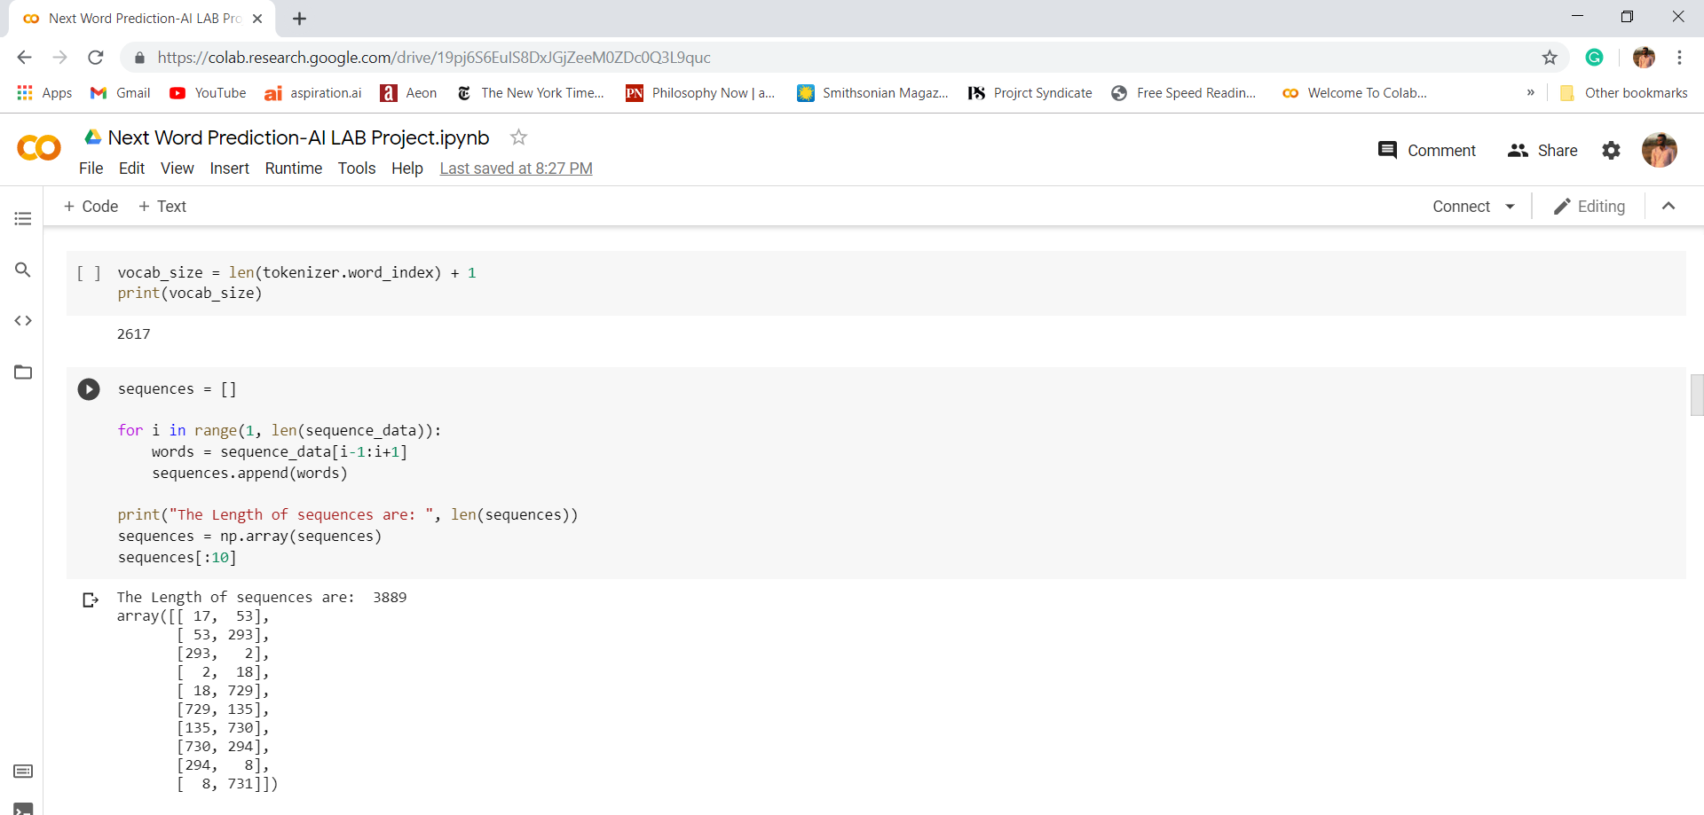

Slide 7
Step 5 :- Creating two elements X(input) and Y(output) and applying one hot encoding on output.
Step 6 :- Creating LSTM model
Step 7 :- Compiling the model
Step 8 :- Fitting the model and running 150 epochs for maximum accuracy.
Step 9 :- Loading the model and tokenizer and finally predict the next word.

Slide 8
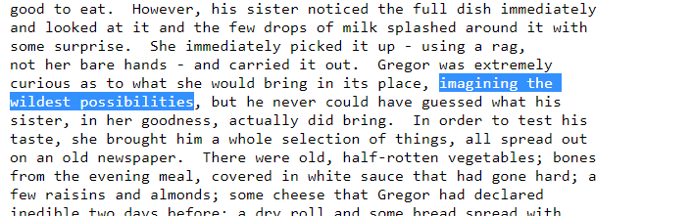
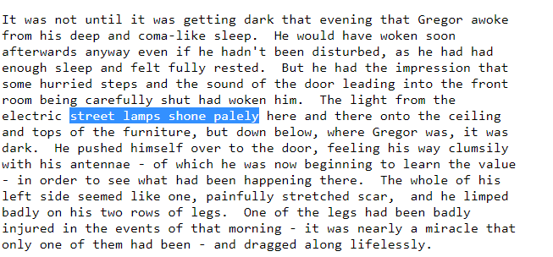
Results

Slide 9
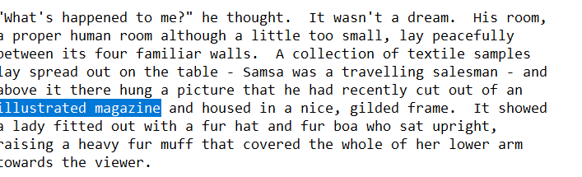
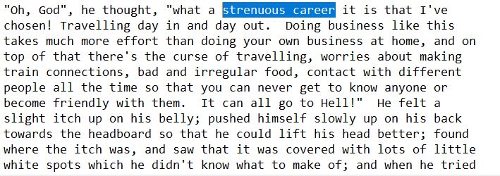

Slide 10
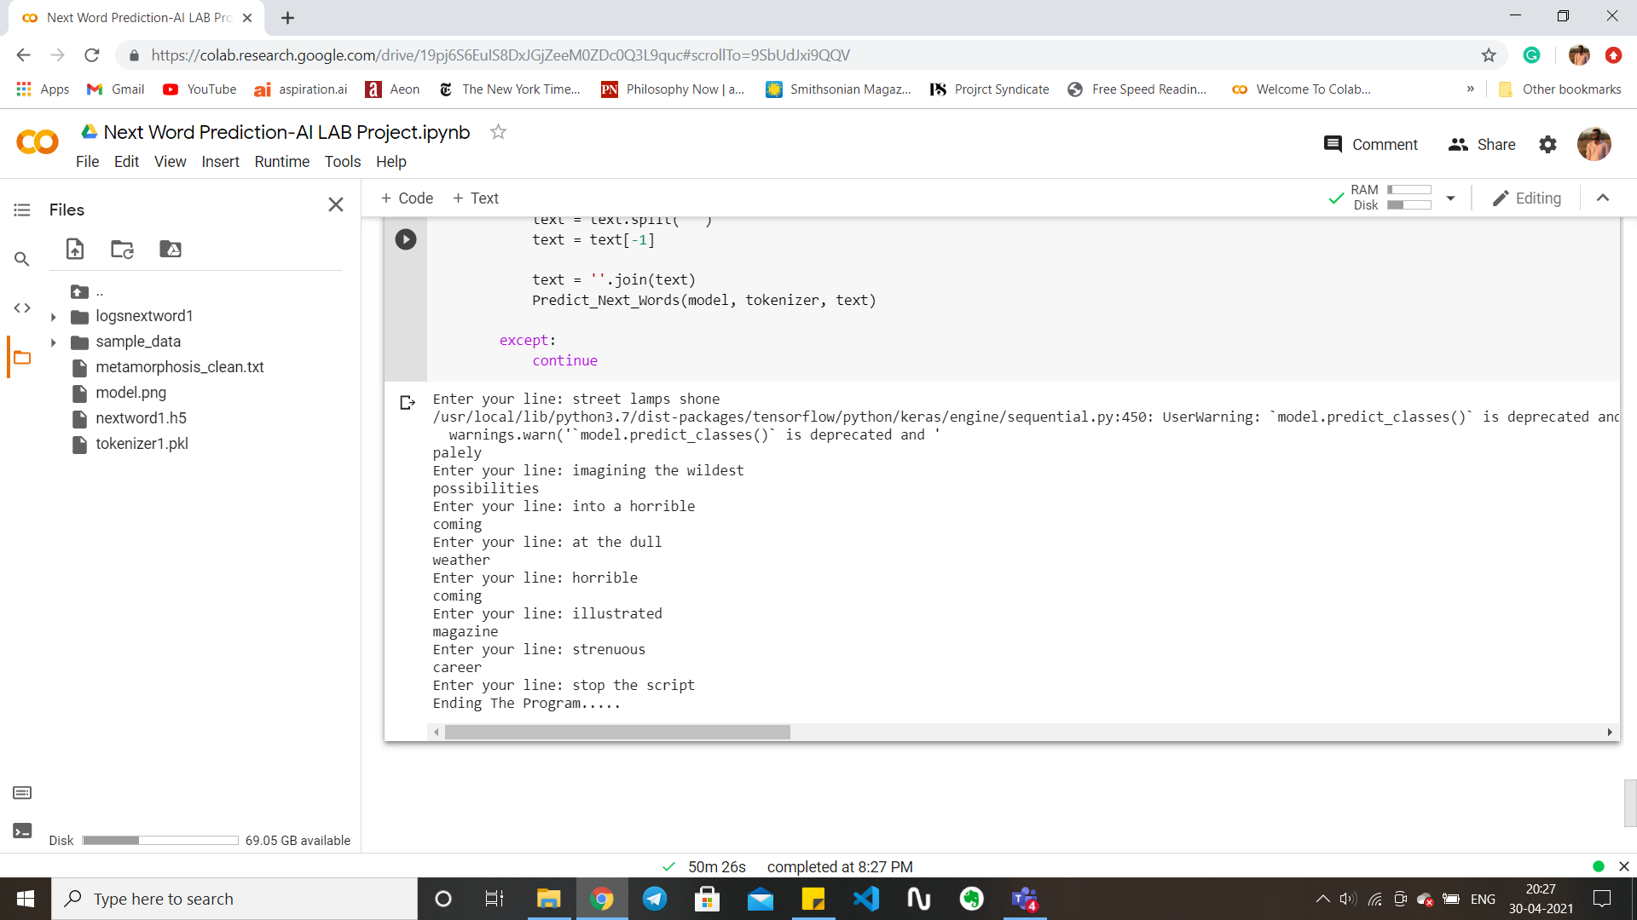

Slide 11
Thank You

